Slide 1
A system that increases the ROI on e-commerce platform.
CECS 550: Pattern Recognition​
Spring 2023
Group #: 8
Pavan Sai Kalyan Badam - 029358574
Akshatha Hebbar​ - 028017780
Instructor: Professor Mahshid Fardadi

Slide 2
Problem Statement
Merchants often gain many new customers through promotions, but a significant portion of these customers are only interested in one-time deals. Therefore, the impact of promotions on long-term sales may be limited. To maximize return on investment (ROI) and reduce promotion costs, it is crucial for merchants to distinguish between one-time buyers and potential loyal customers and focus their efforts on converting the latter group.
In this project, you are provided a dataset with information on promotional shopping event from e-commerce platform. Your task is to design a system which will increase the ROI (in other words, you need to predict the probability that these new buyers would purchase items from the same merchants again within 6 months), reduce promotional cost, and identify one-time buyers

Slide 3
Dataset Information
Data Fields | Definition
user_id | A unique id for the shopper.
age_range | <18 [18,24] [25,29] [30,34] | 5 →[35,39]; 6 → [40,49]; 7,8 → >=50 0 and NULL for unknown.
gender | 0 female 1 male 2 NULL for unknown.
merchant_id | A unique id for the merchant.
label | 1 → repeat buyer for ' merchant_id' , while 0 → not a repeated buyer is the opposite. -1 → not a new customer of the given merchant, NULL → Needs prediction
activity_log | item_id:category_id:brand_id:time_stamp:action_type' . ' #' is used to separate two neighbouring elements. Records are not sorted in any particular order.
The data set used is from data_format2.zip
Retrieve the items 1121 – 1280.
Retrieved data is imbalanced so fetched 20% of rows of label 1.

Slide 4
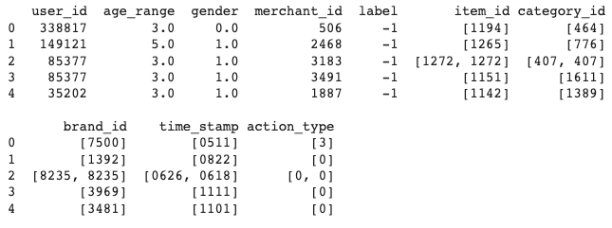
Data Preprocessing
Removing / approximating the null values
Label - No unknown values
Gender and age_range – Missing information is handled with mode along with other column information
Data Filtering activity logs to get Information
Extracted from the activity_log column. The activity_log column is used to extract details such as item_id, category_id, brand_id, time_stamp (converted to %m%d format), and action type

Slide 5
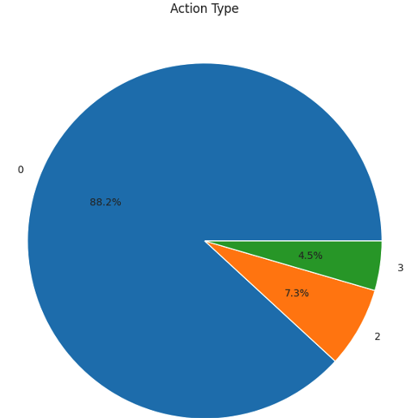
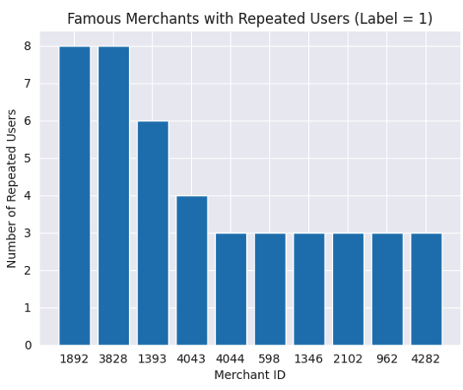
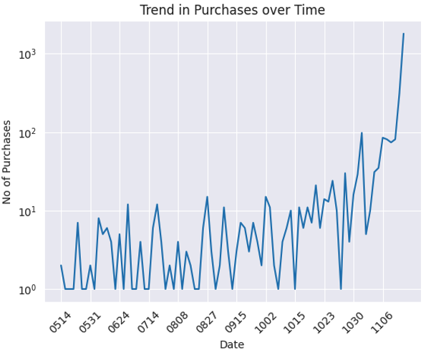
Data Visualization
No. of occurrences of each action type
88% → clicked once
4.5% → Items as favorite
7.3% → making a purchase
Merchants with the highest number of repeat buyers.
Trend in Purchases

Slide 6
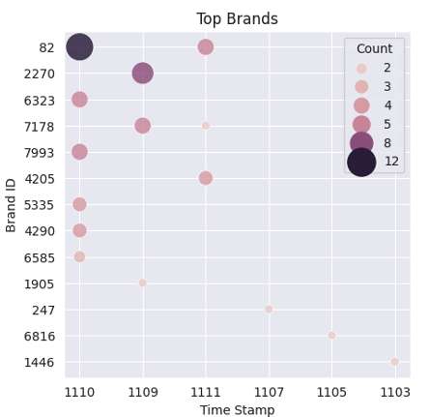
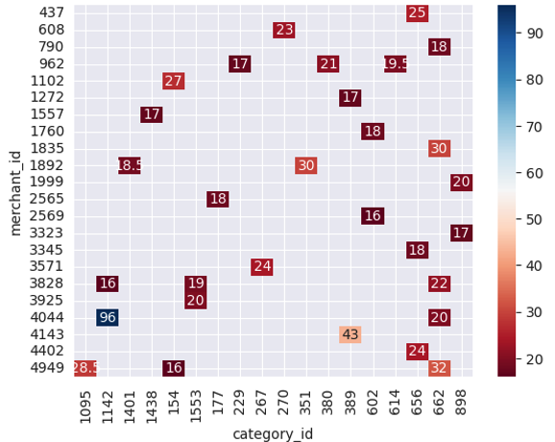
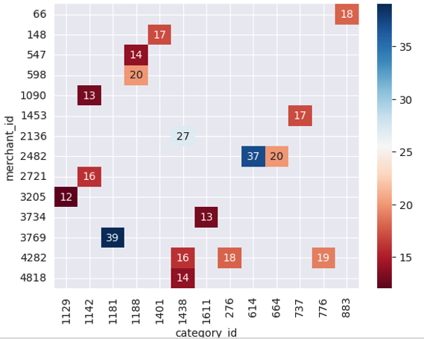
Data Visualization
Preferred category for females (Threshold 15%)
Preferred category for Males (Threshold 10%)
Top brands during highest active month
(November)

Slide 7
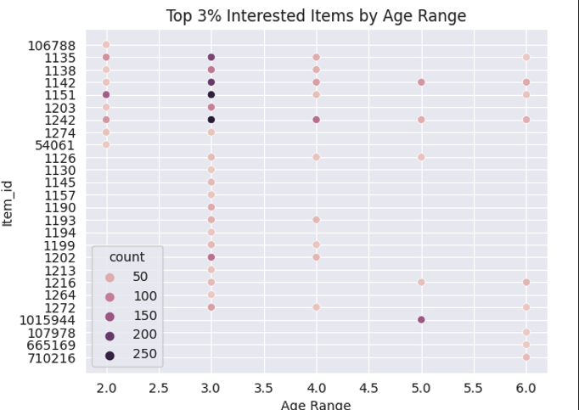
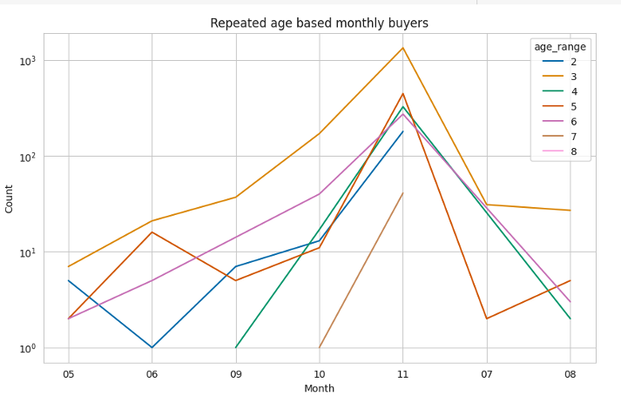
Data Visualization
Top 3% of interested items by age range
Repeated monthly buyers categorized by age group

Slide 8
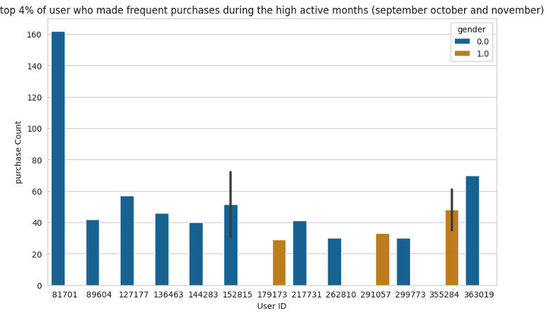
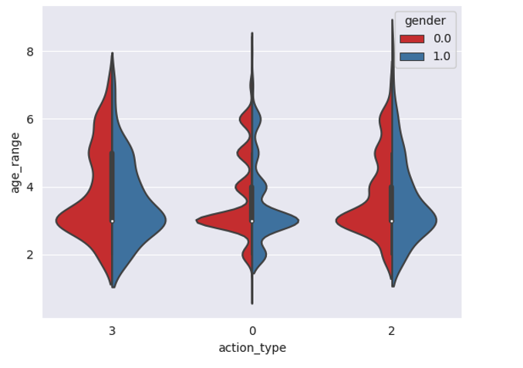
Data Visualization
top 4% of user who made frequent purchases during the high active months (Sept Oct Nov)
Activity based on gender

Slide 9
Feature Engineering
Profile | Title | Column Name | Description | Insight
User Item | Mean of Unique items purchased | ‘avg_unique_items_per_user’ | The mean of unique items purchased by every user is calculated | Customer behavior Analyze preferences
User Merchant | Total actions per user per merchant | ‘total_actions_per_user_merchant’ | Populated by taking the count of all actions of one user on one merchant combinations. | Customer segmentation Recommendation system one-time buyers
User | Proportion of repeated purchases | proportion_of_repeat_buy_days | Calculates the days between two consecutive purchases made by the female users within 30 days threshold | Customer retention User loyalty
Items | Clicked items during highest active months | 'item_clicked_in_oct_nov' | Computed using clicks on every item during the highest active months September, October and November | Predicting user behavior (Sep, Oct, Nov) Item popularity

Slide 10
Feature Engineering
Profile | Title | Column Name | Description | Insight
User Category | Users Category interest | ’num_categories’ | Calculate the count of unique categories users has purchased | Spending patterns User’s category interest
User Brand | Users brand interest | ‘brand_clicks’ | Calculates the average number of clicks per user per brand | Brand Popularity Brand demand
User | Purchase Ratio | ‘purchase_ratio’ | Calculates the proportion of total actions of user leads to a purchase | Future purchase Trajectory
User Brand | Users purchased top brands | ‘users_purchased_top_brands’ ’ | A Boolean value tagging users loyalty towards top brands | Predict new user purchase. Loyalty towards top brands.
User Category | Average days between purchases by a user on a category | ‘avg_days_between_purchases’ | Calculates the number of days the user has made the next purchase by category | User purchase behavior

Slide 11
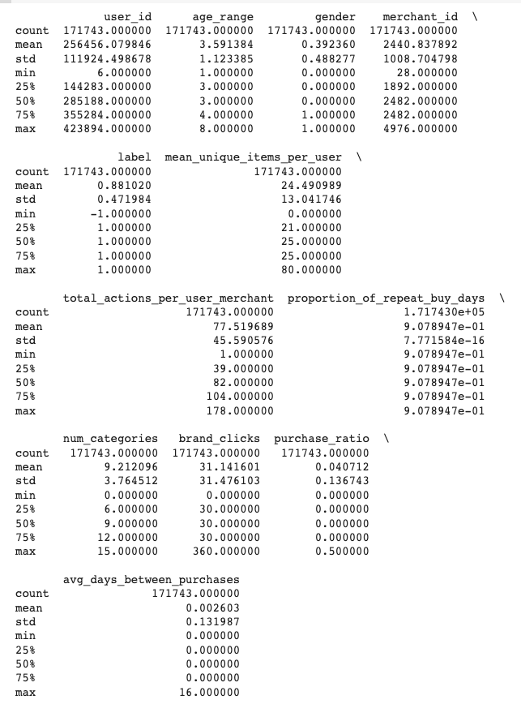
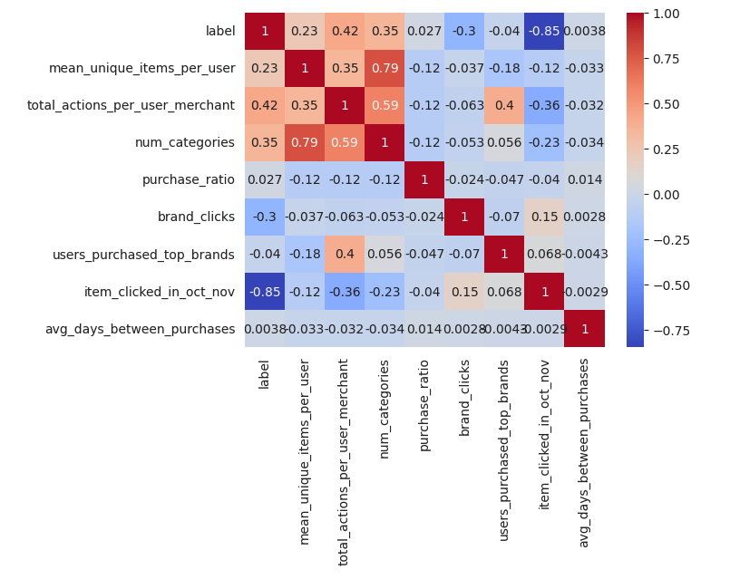
Dataset statistics and feature Ranking
Helps identify the degree of co-relation
Focus on row and column of target variable(label)
High correlation value – absolute(Number)

Slide 12
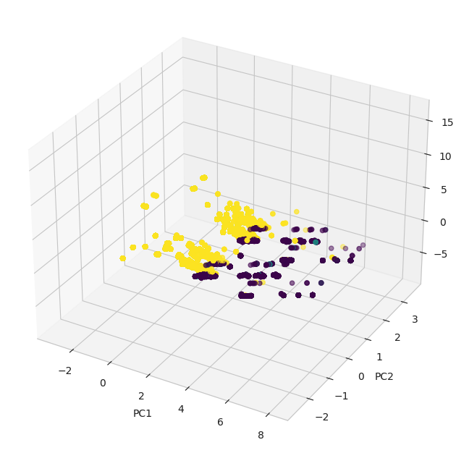
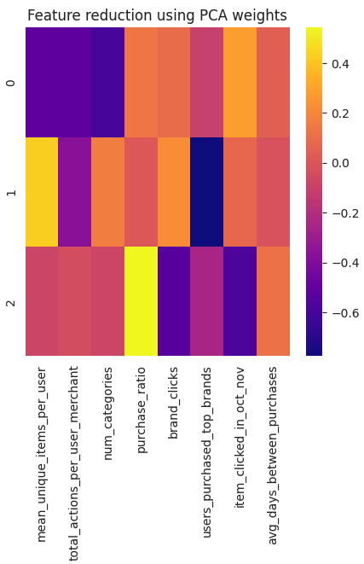
Understanding PCA and Feature Reduction
Principle Component Analysis
Dimensionality Reduction
Technique
Used n_components → 3
Compute variance ratio (PC1 – Highest variance)
Feature Reduction
Low absolute value (Feature Reduction)
Variance Ratio of each component
[0.29340068 0.16108939 0.14183201]

Slide 13
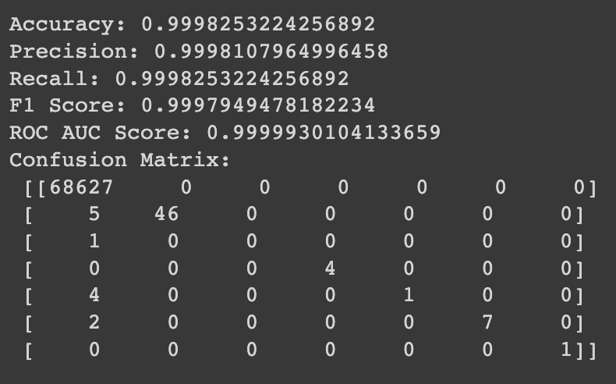
Model Prediction
item_clicked_in_oct_nov is dropped from the engineered features to create consolidated dataset.
K Nearest Neighbors
Supervised learning Algorithm for Classification and regression
Calculating k nearest data points in training test to be given to testing data – VOTE
Model Evaluation
Selecting ‘K’ using cross validation to maximize performance – Hyperparameters
Distance Measure technique used Euclidean, Manhattan and Minkowaski distance
K → 5 and Euclidean distance gave the high performance

Slide 14
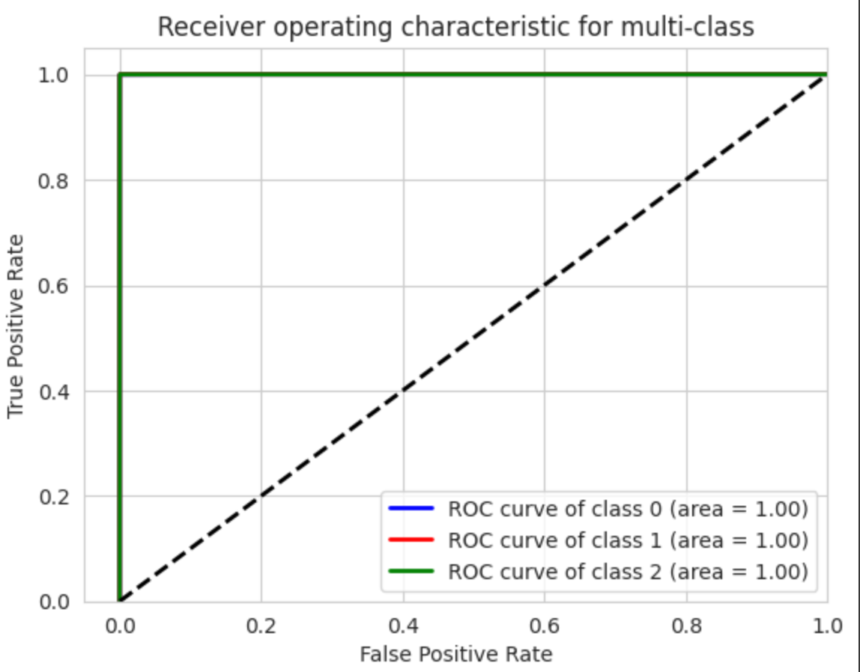
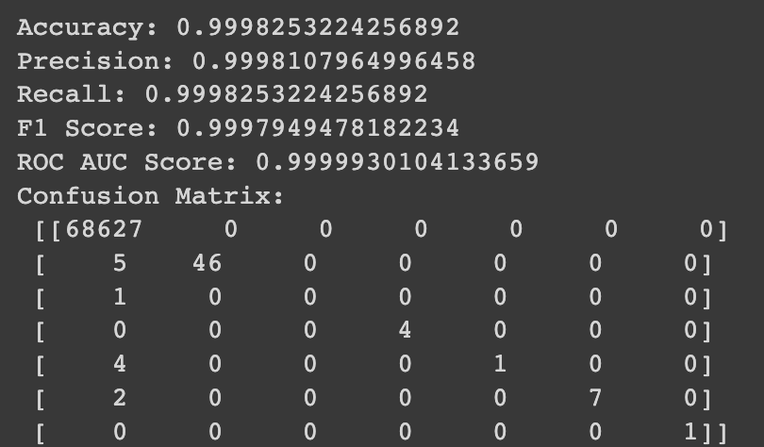
Model Prediction
Parzen Windows
Non parametric density estimation technique
Estimating the probability function(kernel function) created at each data point using window function – density aggregated to get global function.
It is a kernel function assign weights to the nearest data points (point to central window). Bandwidth define smoothness.
Window is calculated by computing density estimation to define boundary space.
Model Evaluation
Kernel type –→gaussian
bandwidth → 1.0 – Hyper parameters

Slide 15
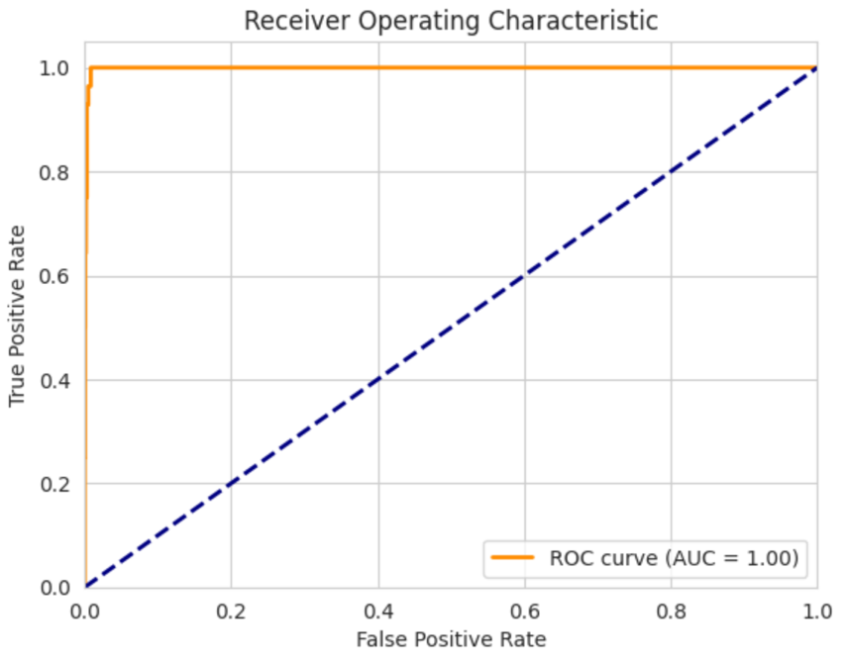
Model Prediction
Neural Network architecture
Multiclass Classification
Two hidden layer with 32 and 16 neurons with ‘relu’ activation function
Output layer with ‘softmax’ classification function gives class probabilities
Model Evaluation
Model is trained on training data → fit()
After training, predict the labels → predict()
Convert predicted labels back to original class label (from one hot encoding)
Evaluated using ROC(plotted) and AUC (calculated)

Slide 16
Model Comparison
K-Nearest Neighbors and Parzen Window classifier achieved similar accuracy and ROC AUC score, indicating that they both are effective at classifying the samples in the dataset.
The K-Nearest Neighbors (8minutes) runs faster than Parzen Window classifier (12 minutes) with easier implementation work and being less expensive.
Discussion
Model Name | Strengths | Weakness
K Nearest Neighbors | Simple to understand No assumption of the underlying data distribution Handles multiclass problems well Less training time | Computation is expensive for larger dataset Choosing K is sensitive Doesn’t handle missing values well

Slide 17
Discussion
Model Name | Strengths | Weakness
Parzen Window | Handles both continuous and discrete data No assumption about underlying distribution Can handle multiclass classification problems | Computationally expensive for large dataset Choice of kernel is sensitive Poor results produced when dimensionality is high Doesn’t handle missing values well
Neural Network | Handles nonlinear relationships between input and output. Learns better with large data Performs Classification, regression, image and speech recognition No need of Feature Engineering | Computationally expensive Vulnerable to overfitting Difficult to analyze how decision is made(black box). Sensitive to hyper parameters

Slide 18
Discussion - Recommendation
Use information from brand clicks and users who has purchased top brands to understand popularity and market brand engagement through social media, influencer marketing.
Use information from mean unique items to sell (complementary samples) of a different product to an existing customer to create brand loyalty thus majorly avoid one time buyers.
Using average days between purchases remind customer through emails to restock their product. Having personalized tailored emails will encourage repeated purchase (increase loyalty) and and reduce one-time buyers.

Slide 19

Thank you
Any Questions

